Slide 1


MARVEL MOVIE RATINGS

Slide 2
User Story
As a user I’m looking to find a cohesive website of the completed first three phases of the Marvel cinematic universe.
WHEN I find a specific movie, once clicked THEN I am shown the trailer of said movie along with ratings for the film.
Description
A collection of Marvel movies from phase 1 – 3 of the Marvel cinematic universe. The movies are ordered by date and the specific phase they are from, once clicked the trailer of the movie will be presented to the user.

Slide 3
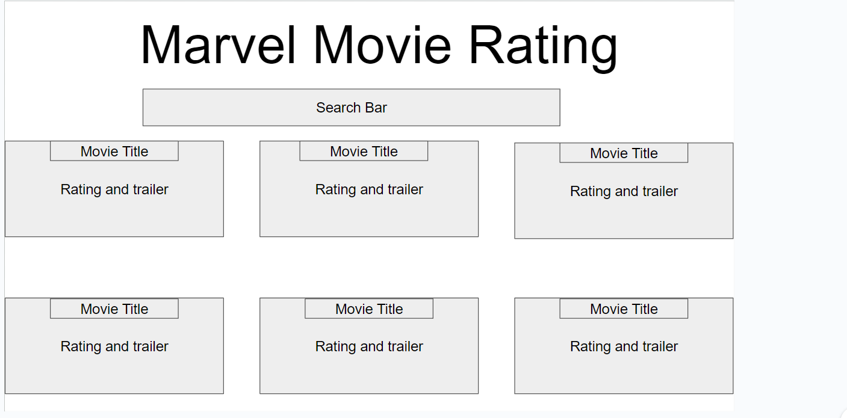

Wireframe

Slide 4

HTML

Slide 5

YOUTUBE API

Slide 6

IMDB API

Slide 7
Deployed Application
https://shanbeezy.github.io/marvel-movie-ratings/

Slide 8
Github Repository
https://github.com/Shanbeezy/marvel-movie-ratings

